Slide 1
Obstacle Detection to aid Visually impaired People
Group Members: Raj Bhensadadia (201501011)
Bansi Gajera (201501028)
Dhwani Mehta (201501054)
Kanan Vyas (201501121)

Slide 2
Project Motivation
Millions of people live in this world with incapacities of understanding the environment due to visual impairment.
Although they can develop alternative approaches to deal with daily routines, they also suffer from certain navigation difficulties as well as social awkwardness.
For example, it is very difficult for them to find a particular room in an unfamiliar environment.
Computer vision technologies have been rapidly developed in recent years. It is promising to use the state-of-art computer vision techniques to help people with vision loss.

Slide 3
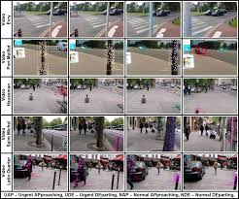
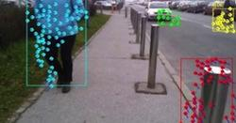
Project Definition
Real Time Obstacle Detection and position estimation, with the goal of informing the visually impaired users about the surrounding obstacles and their spatial position using navigations.
Source: http://cs231n.stanford.edu/reports/2016/pdfs/218_Report.pdf

Slide 4
Deliverables
Obstacle detection – Accurate segmentation of the obstacles.
Obstacle Identification- classifying them into different categories (eg. door, stairs, wall, human,stone etc)
Spatial position estimation - estimated distance of the person from the obstacle.
Navigation- Navigate the user based on the obstacle detection

Slide 5
Literature Survey: Reference Articles
“Assisting the Visually Impaired: Obstacle Detection and Warning System by Acoustic Feedback”, AlbertoRodr´ıguez,J.JavierYebes,PabloF.Alcantarilla,LuisM.Bergas, JavierAlmaz´an and Andr´esCela, Sensors 2012, 12, 17476-17496; doi:10.3390/s121217476
“Real-Time Visual Recognition with Results Converted to 3D Audio”, Rui Jiang, Qian Lin, Shuhui Qu, Stanford
“A Smartphone-Based Obstacle Detection and Classification System for Assisting Visually Impaired People” , Ruxandra Tapu, Bogdan Mocanu, Andrei Bursuc, Titus ZahariaIT/Télécom SudParis, ARTEMIS Department, UMR CNRS MAP5 8145, Evry, France

Slide 6
Contributions
Literature Review : Raj Bhensadadia , Kanan Vyas
Implementation : Kanan Vyas , Bansi Gajera, Dhwani Mehta, Raj Bhensadadia
Analysis : Dhwani Mehta , Raj Bhensadadia
Documentation : Dhwani Mehta, Bansi Gajera

Slide 7
Thank You

